Slide 1
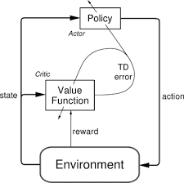
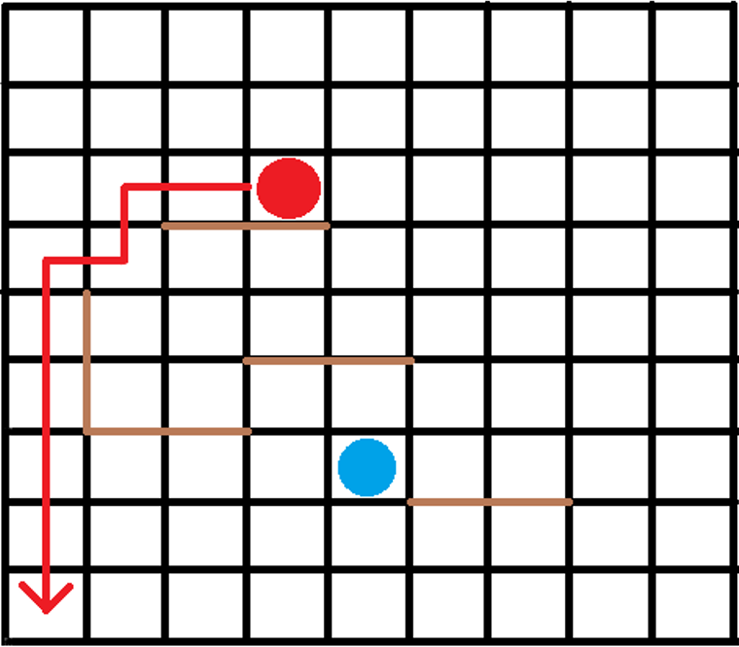
A2C vs Lee Algorithm on the Quoridor game
Babeș Bolyai University
Spiridon Dragoș

Slide 2
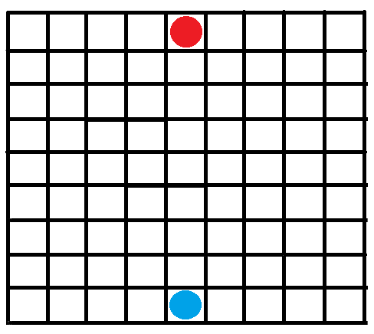
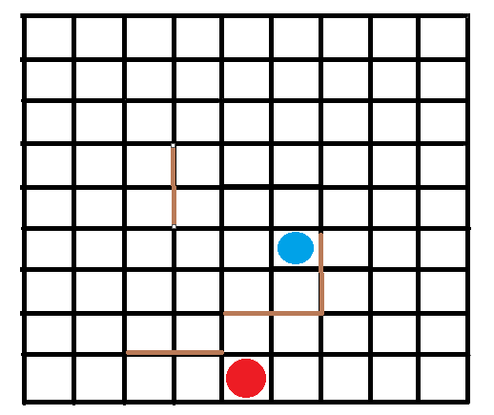
What is Quoridor?
A 2 player strategy game played on a board of 81 (9x9) square spaces
Each player has 10 walls
A wall is used to trouble the path of the other player
The objective is to get your pawn to the opposite side of the board
Red is the winner!

Slide 3
What is the Lee Algorithm?
The Lee algorithm is one possible solution for maze routing problems based on breadth-first search. It always gives an optimal solution, if one exists, but is slow and requires considerable memory.
The shortest path to the opposite side

Slide 4
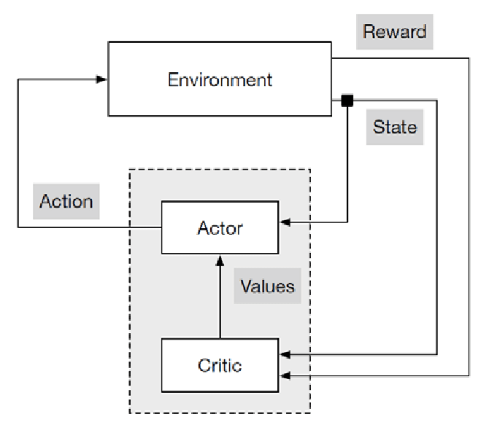
What is A2C ( Advatange Actor Critic)?
Actor-critic learning is a deep reinforcement-learning technique which combines two other reinforcement methods: policy based ( REINFORCEMENT) and value based ( Q Learning).

Slide 5
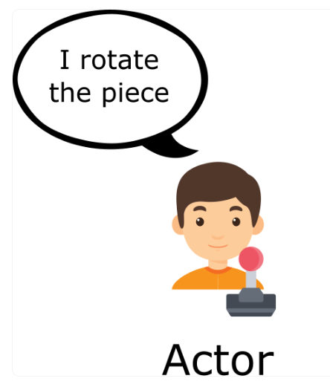
Actor
Actor uses a policy function, and a neural network gives a discrete distribution with each action, and it learns the critic’s policy, and also learns to choose better the actions.
I move down

Slide 6
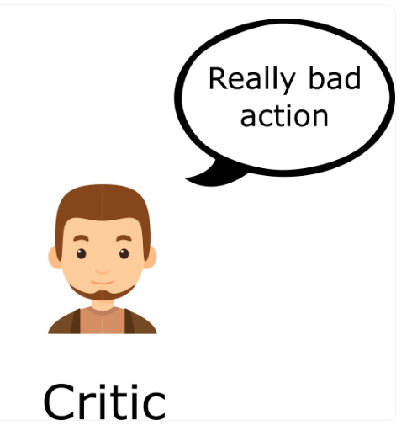
Critic
Critic uses a value function, and also a neural network, but different from the actor’s, which gives a feedback based on a value, and it also learns better ways to provide feedback so it can be better next time.

Slide 7
Approach
Using a reward system – reward the actor if the action:
Lengthens the shortest path of the opponent
Moves on the fastest path to the opposite part
Wins the game
And punish the actor if the action:
Is wrong, like trying to move over a wall, or putting a wall where there already is a wall ( it will happen a lot first times)
Puts more than 10 walls
Blocks definitely the path of the opponent to the opposite part
Loses the game
And do nothing in other cases.

Slide 8
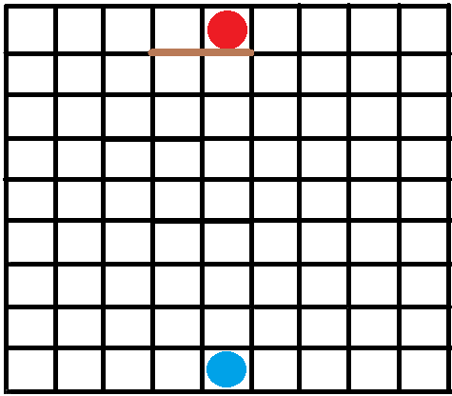
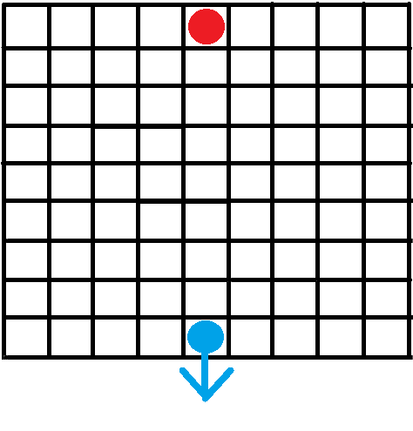
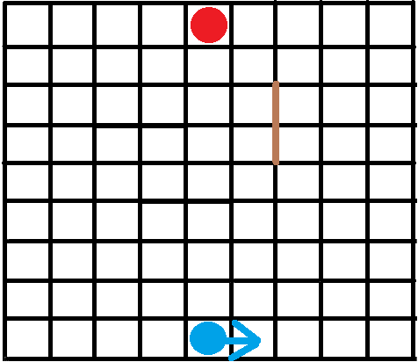
Good action
Bad action (???)
Nothing happens

Slide 9
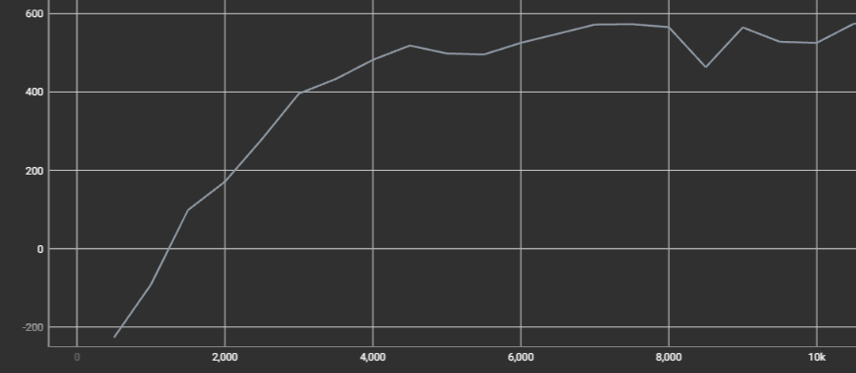
Analytics & Conclusion
Analytics
Good reward
Learns only to move forward
Rarely puts walls, but aprox.
good walls
Conclusion
A good start in the reinforcement part of the AI
Very complex algorithms
Weak “AI” pawn / Opponent too weak
Graph of the mean reward for each episode/ game finished

Slide 10
Thanks for watching!!!

